Slide 1
Case Example 3: Semi-Mechanistic Model to Describe Chemotherapy-Induced Myelosuppression
nlmixr course PAGE 2019 Stockholm, June 11th 2019
Yuan Xiong
On behalf of the nlmixr development team:
Matt Fidler, Richard Hooijmaijers, Teun Post, Rik Schoemaker, Mirjam Trame, Justin Wilkins, Yuan Xiong and Wenping Wang

Slide 2
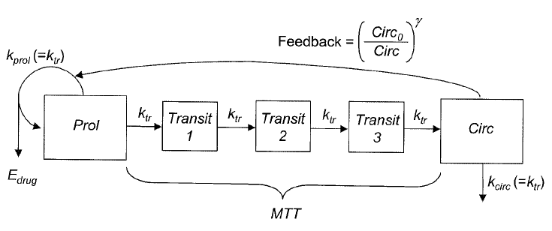
Model overview
Publication
Model of chemotherapy-induced myelosuppression with parameter consistency across drugs. Friberg LE, Henningsson A, Maas H, Nguyen L, Karlsson MO. Journal of Clinical Oncology, Vol 20, No. 24, 2002: pp 4713–4721
Model structure
2-compartment PK

Slide 3
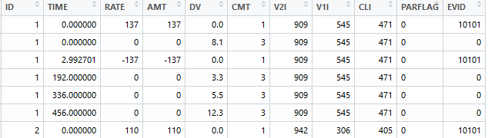
Data
Adapted from DDMoRe Model Repository
DDMODEL00000186: Friberg_2002_Oncology_Paclitaxel_Myelosuppression
45 patients in total
Time courses of white blood cell count after administration of chemotherapeutic drugs observed in individual patients
Number of observations in individuals ranging from 3 to 30 observations
Individual PK parameters are present in the dataset (post-hoc PK parameter estimates from an established population PK model)
Currently using data from TIME=0 up to the last time point with unchanged PK parameters
Minimal change was needed to convert from previous NONMEM dataset

Slide 4
Model building in nlmixr Specification of ODEs: consistent with RxODE
ODEs for a 2-compartment PK model
d/dt(A_centr) = A_periph * Q/V2 - A_centr * (CL/V1 + Q/V1);
d/dt(A_periph) = A_centr * Q/V1 - A_periph * Q/V2;
ODEs for the transit compartment PD model describing proliferative cells, maturing cells, and circulating blood cells
d/dt(A_prol) = KTR * A_prol * EDRUG * FDBK - KTR * A_prol;
d/dt(A_tr1) = KTR * A_prol - KTR * A_tr1;
d/dt(A_tr2) = KTR * A_tr1 - KTR * A_tr2;
d/dt(A_tr3) = KTR * A_tr2 - KTR * A_tr3;
d/dt(A_circ) = KTR * A_tr3 - KTR * A_circ;
2-compartment PK

Slide 5
Model building in nlmixr Specification and initialization of parameters and random effects
Parameters from input dataset – no extra care needed
Individual PK parameters
Parameters to be estimated – modeled in “model” block and initial values provided in “ini” block
Fixed effects
Circulating cells at baseline (CIRC0)
Mean transition time (MTT)
Slope of the linear drug effect on reducing the proliferation rate (SLOPU)
Exponent on the feedback mechanism from the circulating to proliferative cells (GAMMA)
Between-subject variabilities
CIRC0, MTT, SLOPU
Proportional residual error – modeled in “model” block and initial values provided in “ini” block

Slide 6
Further coding in nlmixr
Initial estimates
CIRC0: 7.21
MTT: 124
SLOPU: 28.9
GAMMA: 0.239
Note: all of the above should be provided on the log-scale
Model
Example of parameter model: CIRC0 = exp(log_CIRC0 + eta.CIRC0)
Calculation of PD parameters in the ODEs:
NN = 3;
KTR = (NN + 1)/MTT;
EDRUG = 1 - SLOPU * CONC;
FDBK = (CIRC0 / A_circ)^GAMMA;
Don’t forget to provide initial values for state variables if necessary!
Lastly, specify residual error model

Slide 7
Time to roll with nlmixr!
Read in data
Provided by the data file “Simulated_WBC_pacl_ddmore_samePK_nlmixr.csv”
Fit the data with nlmixr using SAEM estimation algorithm
Check summary of fitting and parameter estimates
Model evaluation
Goodness-of-fit using functions provided by xpose.nlmixr package
Visual predictive checks using function vpc.ui()

Slide 8
Acknowledgement
DDMoRe Model Repository
This case and all result files are made available on the github site https://github.com/nlmixrdevelopment/nlmixr-examples

Slide 9
Appendix: what did we do with the original data?
d0 = read.csv("Simulated_WBC_pacl_ddmore.csv", na.string = ".")
# label records with different PK parameters from TIME=0 for each subject
d1 = d0
d1$PARFLAG = unlist(sapply(unique(d1$ID), function(id) {# id = 1
d1.id = subset(d1, ID==id)
as.numeric(d1.id$V2I != d1.id$V2I[d1.id$TIME==0][1] |
d1.id$V1I != d1.id$V1I[d1.id$TIME==0][1] |
d1.id$CLI != d1.id$CLI[d1.id$TIME==0][1])
}) )
# remove subjects with only dosing records
d2 = subset(d1, ID %in% unique(d1$ID[d1$MDV==0]) & PARFLAG==0)
#write.csv(d2, "Simulated_WBC_pacl_ddmore_samePK.csv", quote=F, row.names=F, na=".")
d3 = nmDataConvert(d2)

